Slide 1
Distributed Computing Terminology & Basic Algorithms
Dr. Barsha Mitra
CSIS Dept, BITS Pilani, Hyderabad Campus

Slide 2
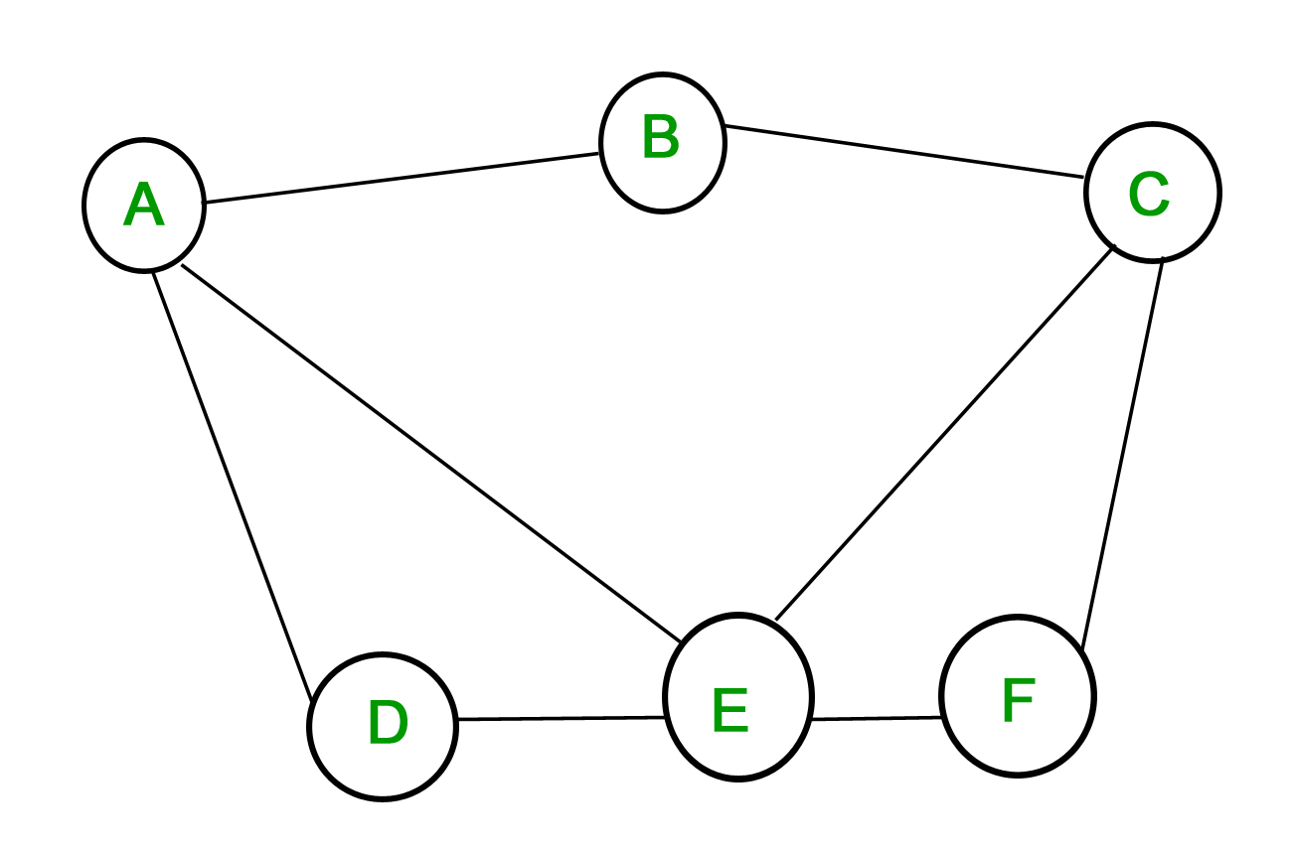
Notation & Definitions
undirected unweighted graph G = (N, L) represents topology
vertices are nodes
edges are channels
n = |N|
l = |L|
diameter of a graph –
minimum number of edges that need to be traversed to go from any node to any other node
diameter = max_{i, j ∈ N} {length of the shortest path between i and j}

Slide 3
Synchronous Single-Initiator Spanning Tree Algorithm using Flooding
algorithm proceeds in rounds (synchronous)
root initiates the algorithm
flooding of QUERY messages
produce a spanning tree rooted at the root node
each process P_{i} (P_{i} ≠ root) should output its own parent for the spanning tree

Slide 4
Synchronous Single-Initiator Spanning Tree Algorithm using Flooding
Local Variables maintained at each P_{i}
int visited
int depth
int parent
set of int Neighbors
Initially at each P_{i}
visited = 0
depth = 0
parent = NULL
Neighbors = set of neighbors

Slide 5
Synchronous Single-Initiator Spanning Tree Algorithm using Flooding
Algorithm for P_{i}
Round r = 1
if P_{i} = root then
visited = 1
depth = 0
send QUERY to Neighbors
if P_{i} receives a QUERY message then
visited = 1
depth = r
parent = root
plan to send QUERYs to Neighbors at next round

Slide 6
Synchronous Single-Initiator Spanning Tree Algorithm using Flooding
Algorithm for P_{i}
Round r > 1 and r <= diameter
if P_{i} planned to send in previous round then
P_{i} sends QUERY to Neighbors
if visited = 0 then
if P_{i} receives QUERY messages then
visited = 1
depth = r
parent = any randomly selected node from which QUERY was received
plan to send QUERY to Neighbors \ {senders of QUERYs received in r}

Slide 7
Synchronous Single-Initiator Spanning Tree Algorithm using Flooding
A
(1)
B
C
QUERY
(1)
F
E
D

Slide 8
Synchronous Single-Initiator Spanning Tree Algorithm using Flooding
A
(1)
B
C
QUERY
(1)
F
E
D

Slide 9
Synchronous Single-Initiator Spanning Tree Algorithm using Flooding
A
B
(2)
C
QUERY
(2)
F
(2)
E
D

Slide 10
Synchronous Single-Initiator Spanning Tree Algorithm using Flooding
A
B
(2)
C
QUERY
(2)
F
(2)
E
D

Slide 11
Synchronous Single-Initiator Spanning Tree Algorithm using Flooding
A
B
C
(3)
QUERY
(3)
(3)
F
E
(3)
D

Slide 12
Synchronous Single-Initiator Spanning Tree Algorithm using Flooding
A
B
C
(3)
QUERY
(3)
(3)
F
E
(3)
D

Slide 13
Synchronous Single-Initiator Spanning Tree Algorithm using Flooding
A
B
C
F
E
D

Slide 14
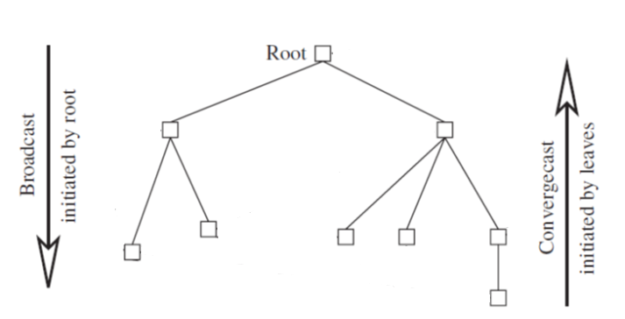
Broadcast and Convergecast on a Tree
A spanning tree is useful for distributing (via a broadcast) and collecting (via a convergecast) information to/from all the nodes
Broadcast Algorithm:
BC1:
The root sends the information to be broadcast to all its children.
BC2:
When a (non-root) node receives information from its parent, it copies it and forwards it to its children.

Slide 15
Broadcast and Convergecast on a Tree
Convergecast Algorithm:
CVC1:
Leaf node sends its report to its parent.
CVC2:
At a non-leaf node that is not the root: When a report is received from all the child nodes, the collective report is sent to the parent.
CVC3:
At the root: When a report is received from all the child nodes, the global function is evaluated using the reports.

Slide 16
Broadcast and Convergecast on a Tree
Complexity
each broadcast and each convergecast requires n − 1 messages
each broadcast and each convergecast requires time equal to the maximum height h of the tree, which is O(n)

Slide 17
Reference
Ajay D. Kshemkalyani, and Mukesh Singhal, Chapter 5, “Distributed Computing: Principles, Algorithms, and Systems”, Cambridge University Press, 2008.

Slide 18
Thank You

